Slide 1
LEADERSHIP STYLES
WWWCARIBBEAN TRAINING

Slide 2
OBJECTIVES
IDENTIFY DIFFERENT TYPES OF LEADERSHIP SYTLES
IDENTIFY YOUR LEADERSHIP STYLE
EXAMINE THE TYPES OF LEADERS SHOWN IN JUDGES 9 8-15
COMPARE LEADERSHIP STYLES IN THE BIBLE

Slide 3
AUTHORITATIVE
AUTOCRATIC
AFFILIATIVE
COACHING
PACE SETTING
DEMOCRATIC
LEADERSHIP STYLES

Slide 4
JUDGES 9 8-15
Once the trees went forth to anoint a king over them, and they said to the olive tree, ‘Reign over us!’ ⁹ But the olive tree said to them, ‘Should I give up my fatness by which God and men are honored, and go to wave over the trees?’ ¹⁰ Then the trees said to the fig tree, ‘You come and reign over us!’ ¹¹ But the fig tree said to them, ‘Should I give up my sweetness and my good fruit, and go to wave over the trees?’ ¹² Then the trees said to the vine, ‘You come and reign over us.’ ¹³ And the vine replied, ‘Should I give up my new wine, which makes God and men happy, and go to wave over the trees?’ ¹⁴ Then all the trees said to the bramble, ‘You come and reign over us.’ ¹⁵ So the bramble said to the trees, ‘If in truth you are anointing me king over you, then come and take refuge in my shade; but if not, let fire come out of the bramble and devour the cedars of Lebanon.’

Slide 5
Autocratic Style
LEADERSHIP
STYLES
"Do as I say."
Make all the decisions with little input from team members.
CAN BE USED WHEN…
Crucial decisions need to be made on the spot
Dealing with inexperienced team members.

Slide 6
Authoritative Style
LEADERSHIP
STYLES
“Follow me”
Take the time to explain their thinking
They allow people choice and latitude on how to achieve common goals.

Slide 7
Pacesetting Style
LEADERSHIP
STYLES
“Do as I do!"
A very driven leader
Effective in getting things done and driving for results.
It's a style that can hurt team members.
Employees may become stressed working under this style of leadership
Cause team burnout.

Slide 8
Democratic Style
LEADERSHIP
STYLES
"What do you think?"
They also seek employees’ opinions before approving a final decision
Get people to do what you want to be done but in a way that they want to do it

Slide 9
Democratic Style
LEADERSHIP
STYLES
"What do you think?"
Can this be used in crunch time?

Slide 10
Coaching Style
LEADERSHIP
STYLES
"Consider this" approach
A coaching leader gives people a little direction to help them tap into their ability to achieve all that they're capable of.

Slide 11
Coaching Style
LEADERSHIP
STYLES
" Consider this "
In what scenario can this be problematic?

Slide 12
Affiliative Style
LEADERSHIP
STYLES
"People come first."
About encouraging harmony and forming collaborative relationships
USEFUL WHEN…
Smoothing conflicts among team members or Reassuring people during times of stress.

Slide 13
HOW DO YOU DETERMINE YOUR LEADERSHIP STYLE
Know yourself.
Understand the different styles.
Your dominant leadership style
Take a leadership style assessment.

Slide 14
HOW DO YOU DETERMINE YOUR LEADERSHIP STYLE
Practice makes a leader
Develop your leadership agility
An amalgam of most of different leadership styles
An agile leadership style may be the ultimate leadership style required
Practice the new behaviors until they become natural

Slide 15
LEADERSHIP STYLES IN JUDGES 9 8-15

Slide 16
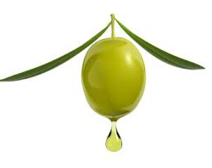
But the olive tree said to them, ‘Should I give up my fatness by which God and men are honored
OLIVE TREE LEADERS

Slide 17
READERS PLEASE!!!
EXODUS 4 VS 10-13
JEREMIAH 1 VS 6-8

Slide 18
But the olive tree said to them, ‘Should I give up my fatness by which God and men are honored
The Olive tree produces ”Illuminating Oil
- In this kind of leadership, you can never walk in darkness
Olive tree leaders are:
Totally sold out for God
Servant Leaders
Anointed
Produce Oil
Depend totally on God

Slide 19
OLIVE TREE LEADER- MOSES
DEPENDANT - ¹¹ But Moses said to God, “Who am I, that I should go to Pharaoh, and that I should bring the children of Israel out of Egypt?” ¹² And God said, “Certainly I will be with you, and this shall be the sign to you that it is I who have sent you: when you have brought the people out of Egypt, you shall serve and worship God at this mountain.”
OBEDIENT- And the Lord said to him, “What is that in your hand?” And he said, “A staff.” ³ Then He said, “Throw it on the ground.” So Moses threw it on the ground, and it became a [living] serpent [like the royal symbol on the crown of Pharaoh]; and Moses ran from it. ⁴ But the Lord said to Moses, “Reach out your hand and grasp it by the tail.” So he reached out his hand and caught it, and it became a staff in his hand—

Slide 20
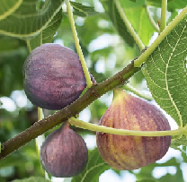
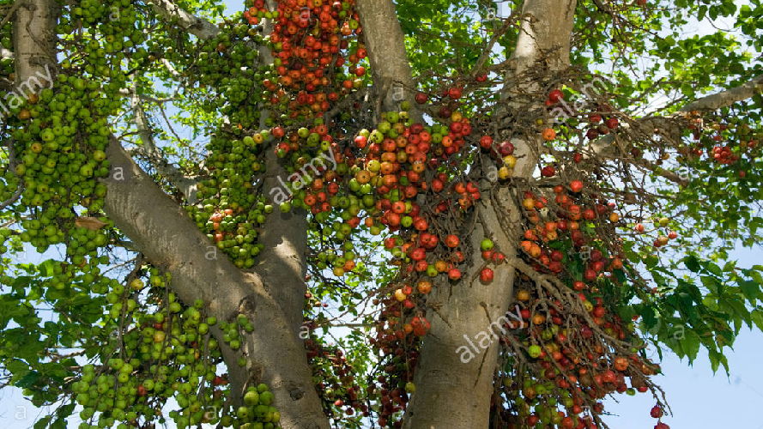
But the fig tree said to them, ‘Should I give up my sweetness and my good fruit, and go to wave over the trees?
FIG TREE LEADERS

Slide 21
READERS PLEASE!!!
MATTHEW 13 VS 23
GALATIANS 5 VS 22-23

Slide 22
But the fig tree said to them, ‘Should I give up my sweetness and my good fruit, and go to wave over the trees?
This leadership is characterized by harmony, sweetness and good character of the followers because the leader possess these same traits.
Fig Tree Leaders are:
Good natured
Welcoming
Charismatic,
Put people at ease
Not good in stressful situations

Slide 23
FIG TREE LEADER-SOLOMON
CHARISMATIC- ⁴ People came from all the peoples (nations) to hear the wisdom of Solomon, and from all the kings of the earth who had heard of his wisdom.1 KINGS 4:34
PUTS PEOPLE AT EASE- When Hiram heard the words of Solomon, he rejoiced greatly and said, “Blessed be the Lord this day, who has given David a wise son [to be king] over this great people.” So Hiram gave Solomon all the cedar and cypress timber he desired1 KINGS 5:7, 10

Slide 24
FIG TREE LEADER-SOLOMON
All your fortresses are [nothing but] fig trees with ripe figs— When shaken they fall into the mouth of the eater. Nahum 3:12
²⁴ As soon as Pharaoh’s daughter came up from the City of David to her house which Solomon had built for her, then he built the Millo (fortification).1 Kings 9:25
³ He had seven hundred wives, princesses, and three hundred ^{[b]}concubines, and his wives turned his heart away [from God]. ⁴ For when Solomon was old, his wives turned his heart away after other gods; and his heart was not completely devoted to the Lord his God,1 Kings 11 3-4

Slide 25
LEADERS IN THE BIBLE
They maintain a personal vibrant relationship with God right up to the end.
They maintain a learning posture and can learn from various kinds of sources— life especially
Truth is lived out in their lives so that convictions and promises of God are seen to be real.
They walk with a growing awareness of a sense of destiny and see some or all of it fulfilled

Slide 26
CHOOSE TWO OF THESE LEADERS IN THE BIBLE AND IDENTIFY ANY OLIVE TREE LEADER AND/ OR FIG TREE LEADER CHARACTERISTICS
DAVID
DEBORAH
DANIEL
MIRIAM
ISAAC
ESTHER
RUTH
GIDEON

Slide 27
LEADERS IN THE BIBLE https://wailingwomenworldwide-caribbean.org/
DAVID
DEBORAH
DANIEL
ISAAC
MIRIAM
ESTHER
RUTH
GIDEON

